Slide 1
AI for coding and research

Slide 2
Good AI coding practices
What works and what doesn’t

Slide 3
Good (acceptable) use cases
Autocomplete
Small chunks of code
Longer chunks of code that in principle you know how to write
Code that you don’t want to write (or don’t know how to), but you know what the result of the output should be (aka vibe coding)

Slide 4
Demo: copilot

Slide 5
Demo: coding with chat bot

Slide 6
Failure modes and bad practices
Demo? List of things NOT to do?

Slide 7
Practice: VS Code

Slide 8
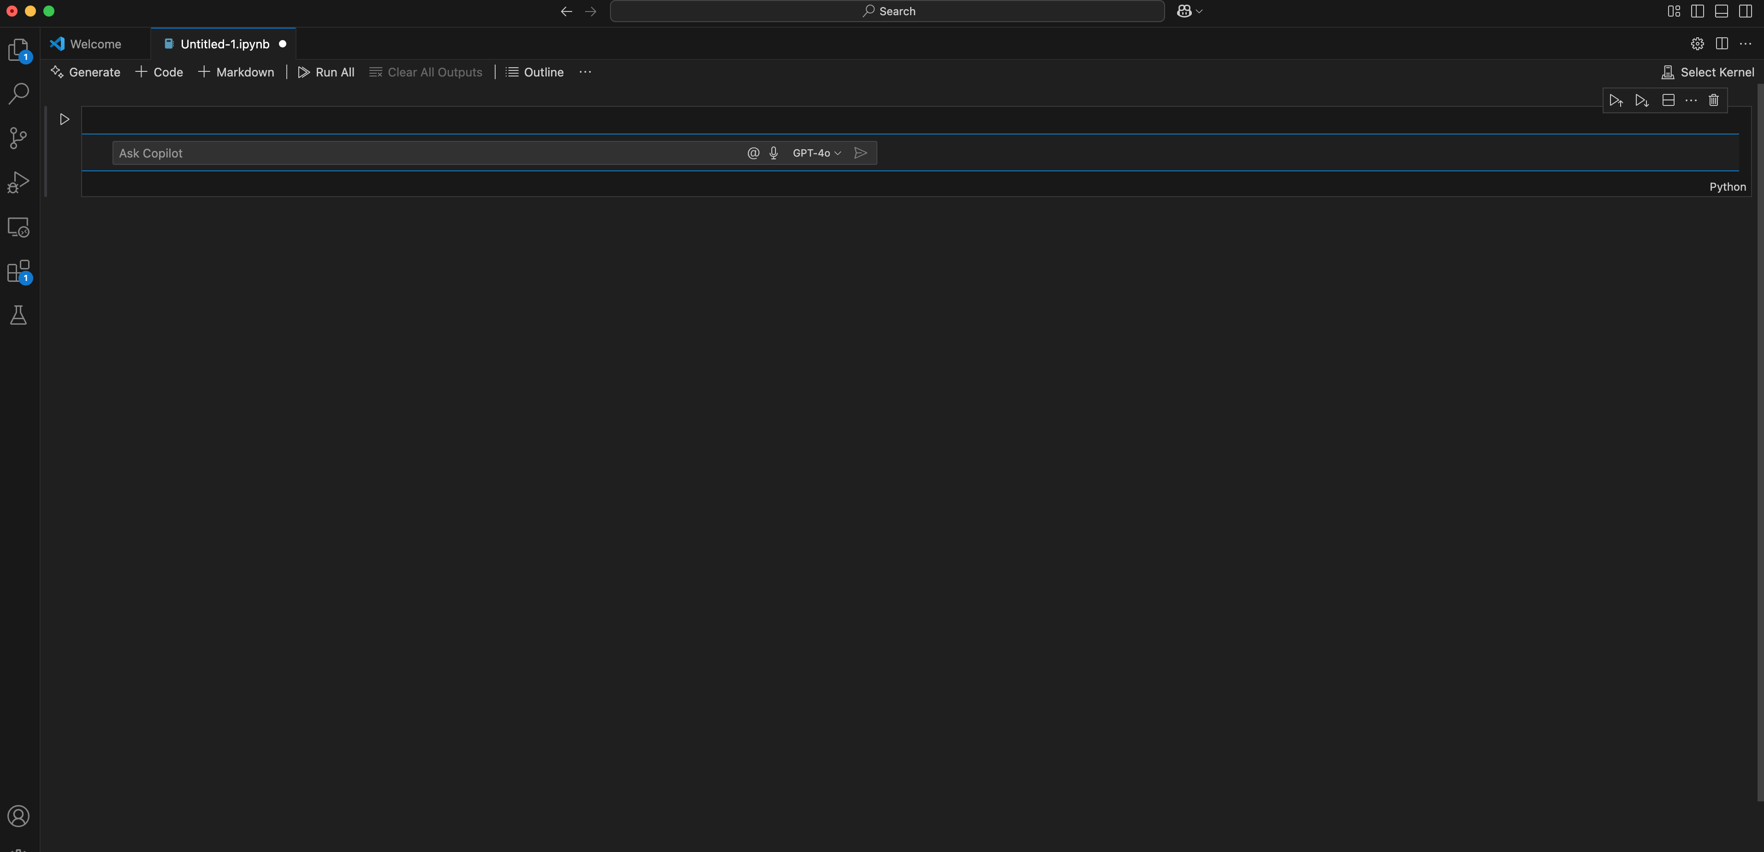

Slide 9
AI for research
What works and what doesn’t

Slide 10
Prompt engineering
Examples of prompts here

Slide 11
Prompt engineering
Time it takes/ reasons to do

Slide 12
Prompt engineering: Demo

